Slide 1
DIABETES PREDICTION AND EDA,CLASSIFICATION USING MACHINE LEARNING
PROJECT PRESENTATION BY
MONICA EZHILARASI
MANIDEEP CHELIME
SHUBHANGI M

Slide 2
DATA SCIENCE LIFECYCLE
01 Problem Statement
02 Data Mining
03 Data Cleaning
04 Data Exploration
05 Feature Engineering
06 Predictive Modeling

Slide 3
Data Mining
Problem
Statement
Diabetes is a chronic disease with the potential to cause a worldwide health care crisis. According to International Diabetes Federation 382 million people are living with diabetes across the whole world. By 2035, this will be doubled as 592 million.
This dataset is used to predict whether a patient is likely to get diabetes attack based on the input parameters like gender, age, various diseases, and smoking status. Each row in the data provides relevant information about the patient.

Slide 4
ATTRIBUTE INFORMATION
1)Gender:"Male", "Female" or "Other“
2)Age: Age ranges from 0-80 in our dataset.
3)Hypertension: Hypertension is a medical condition in which the blood pressure in the arteries is persistently elevated. 0 if the patient doesn't have hypertension, 1 if the patient has hypertension.
4)Heart Disease: Heart disease is another medical condition that is associated with an increased risk of developing diabetes. Here also 0 if the patient doesn't have heart disease , 1 if the patient has heart disease.
5)Smoking History: Smoking history is also considered as a risk factor on Diabetes. It represents smoking history of the patient.
6)BMI(Body Mass Index): BMI (Body Mass Index) is a measure of body fat based on weight and height. Patients with higher BMI are known for having more risk of suffering from diabetes.
7)HbA1c Level: HbA1c (Hemoglobin A1c) level is a measure of a person's average blood sugar level over the past 2-3 months.
8)Blood Glucose Level: Blood glucose level refers to the amount of glucose in the bloodstream at a given time.
9)Diabetes: Represents the patient if he/she has diabetes or not. 0 is negative, 1 is positive.

Slide 5
Existing System & Gap on Existing System
Machine Learning and Neural Networks approach.
Age, Heart Disease, Average Glucose Level for
Predicting diabetics.
Diabetics Prediction Model For African
Populations using conditional logistic regression.
Machine Learning techniques can provide an early and low-cost diagnosis.
Several studies have analysed the importance of lifestyle types, medical records of patients on the probability of the patients to develop diabetics . Further, machine learning models are also now employed to predict the occurrence of diabetics.
However, there is no study that attempts to analyse all the conditions related to patient, and identify the key factors necessary for diabetics prediction.

Slide 6
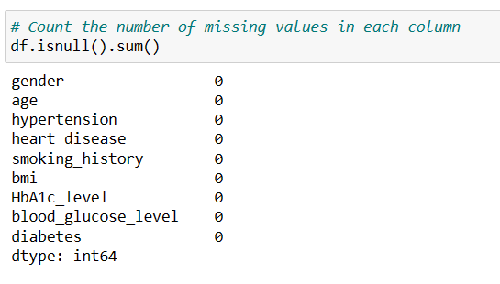
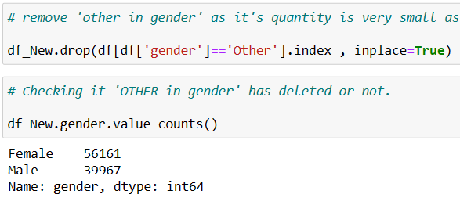
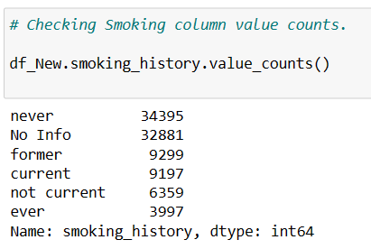
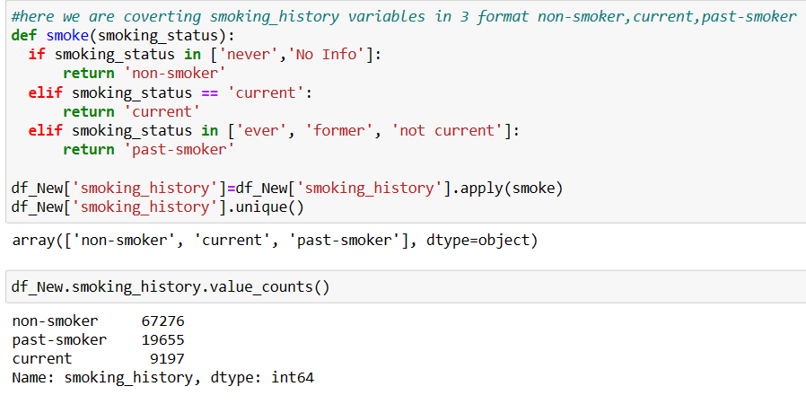
DATA CLEANING

Slide 7
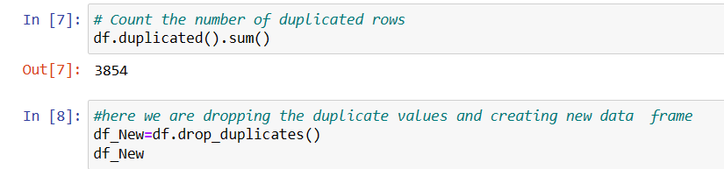
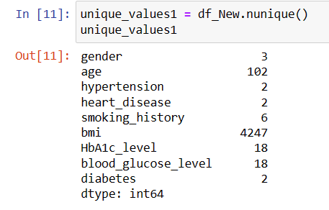
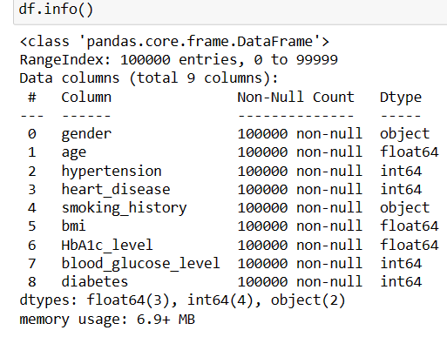
DATA CLEANING

Slide 8
EDA Exploratory Data Analytics

Slide 9
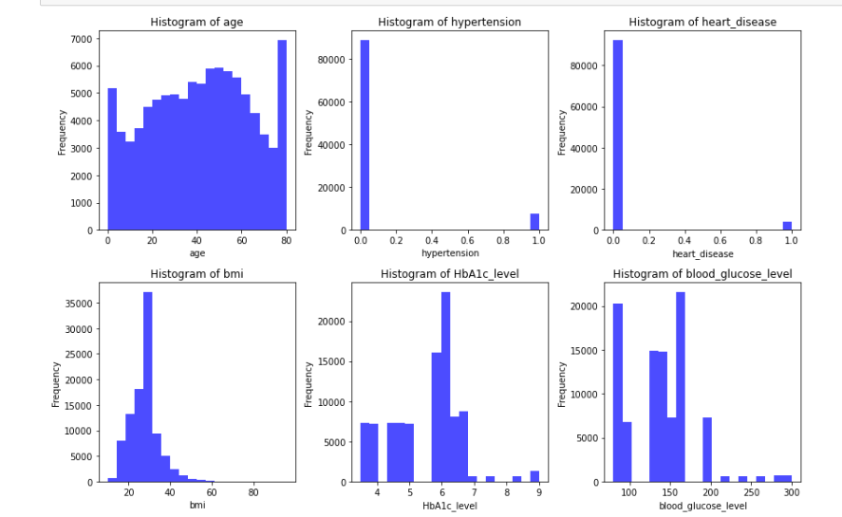
CONTINUOUS VARIABLE

Slide 10
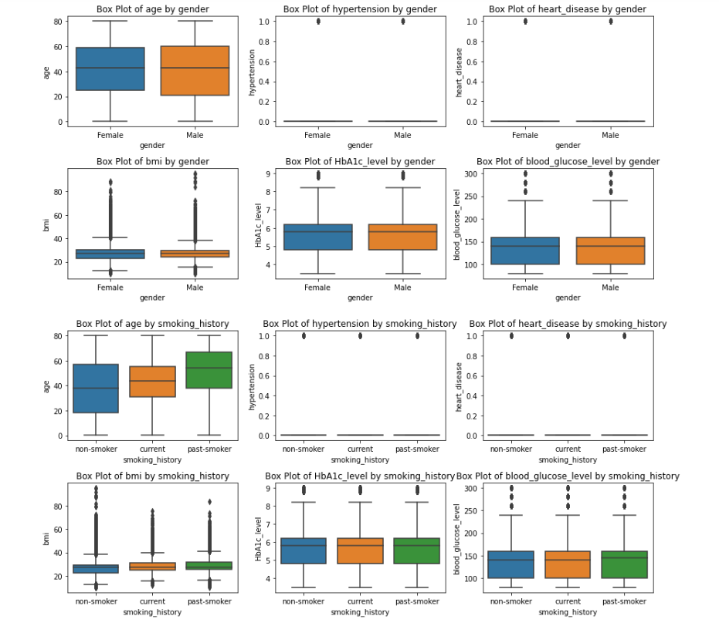
Bar Plots For Continuous Vs Categorical Variables

Slide 11
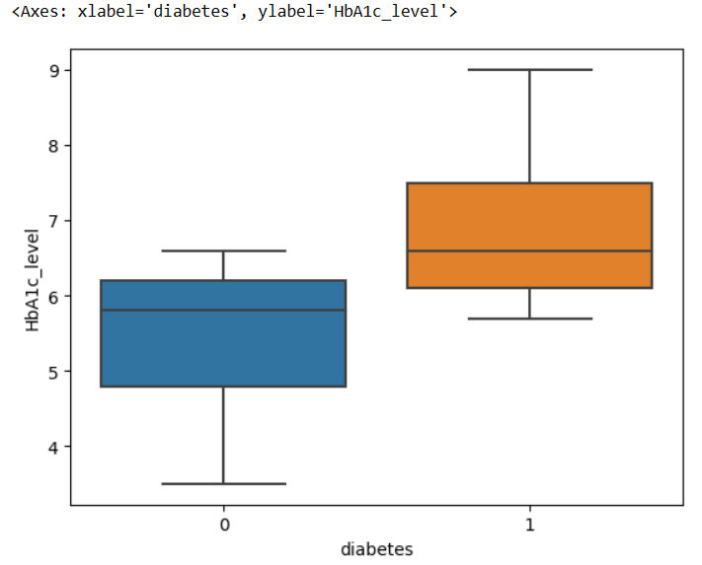
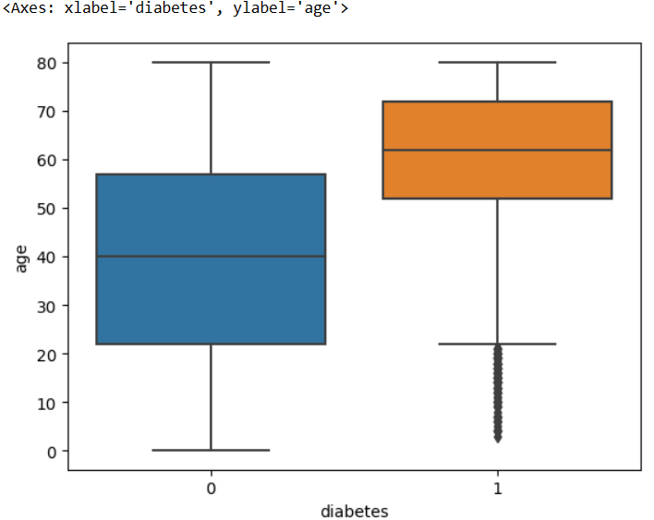
CONTINOUS VS CONTINOUS CHARTS
Visualizing Age vs Diabetes
From this graph we can conclude that most
of the patients that have diabetes
are between the age of 52-75
Visualizing a boxplot between diabetes and HbA1c_level
From this boxplot, we can conclude that most of the patients that have `diabetes` have `HbA1c_level` between `6-8`.

Slide 12
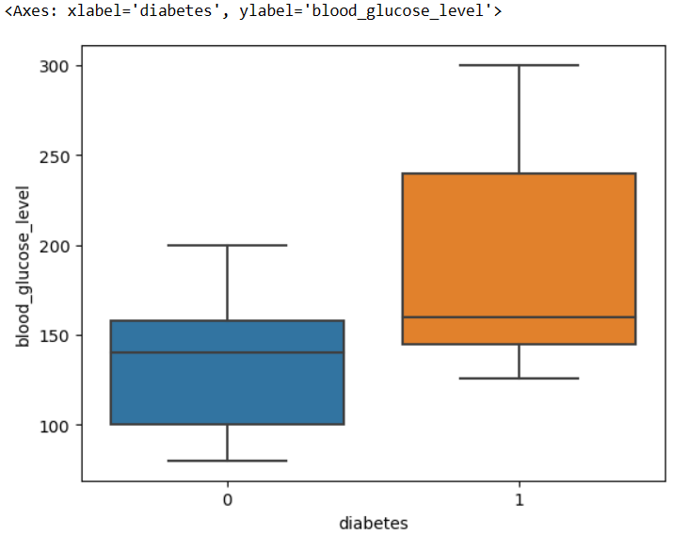
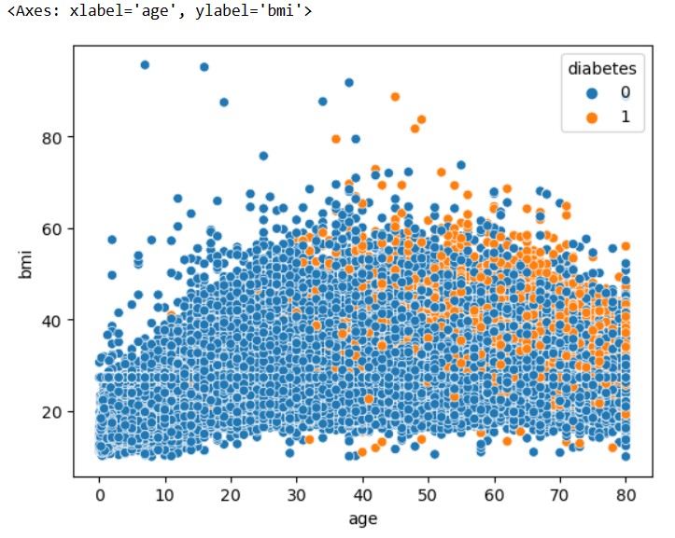
CONTINOUS VS CONTINOUS CHARTS
Visualizing a scatterplot between age and BMI
From this graph, we can conclude that if the patient’s age is above 35 and BMI is above 28, then the chances of diabetes increase drastically. As we can see in the red circle the quantity of patients having diabetes is quite high
Visualizing a boxplot between diabetes and blood glucose level
From this boxplot, we can conclude that most of the patients that have diabetes have blood_glucose_level between 150-250

Slide 13
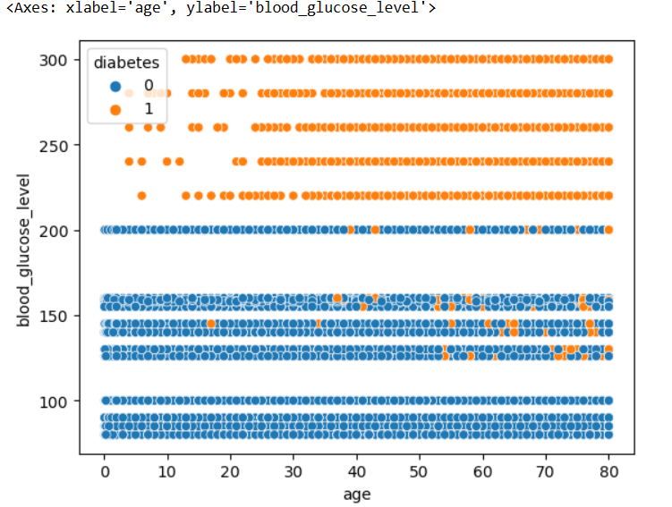
Visualizing a scatterplot between `age` and `blood_glucose_level
We can without a doubt conclude from this graph that if your `blood_glucose_level` is above 200, no matter what the patient’s age is there is a 99-100% probability that the patient has diabetes One more thing that we can conclude from this graph is that if the patient’s age` is above `50` and has `a blood_glucose_level` between 125-170 there is a chance that the patient might have `diabetes`

Slide 14
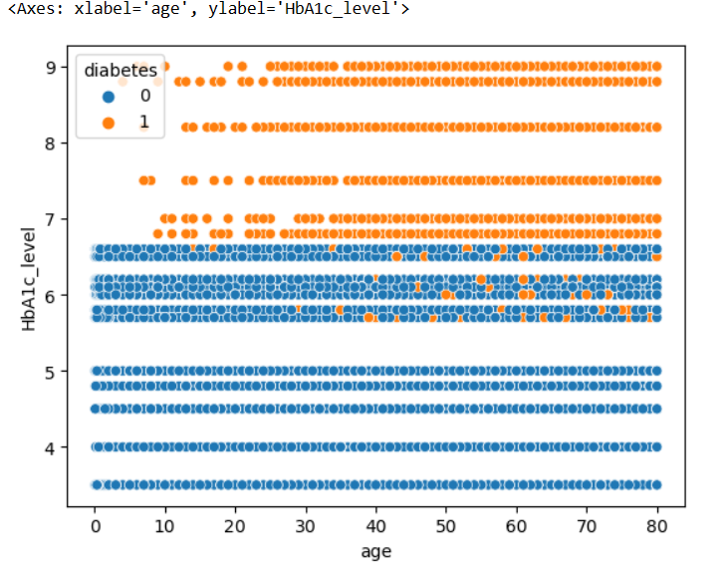
Visualizing a scatterplot between age and HbA1c_level We can conclude from this plot that if a patient has over 6.7 HbA1c_level, whatever the age it is 98-100% probability that a patient has diabetes Also, we can conclude that if a patient has a HbA1c_level above 5.8 and age above 40 chances increase of the patient being diagnosed with diabetes

Slide 15
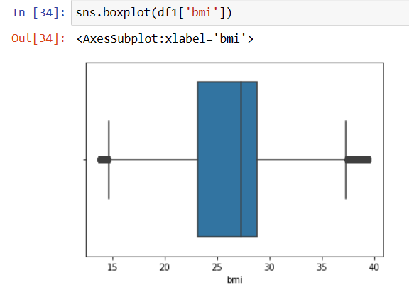
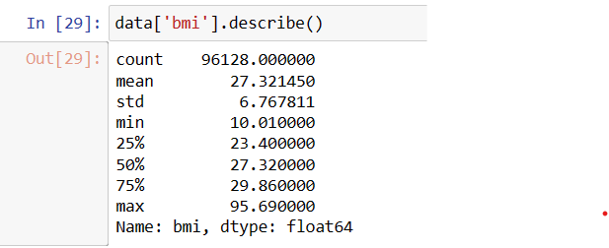
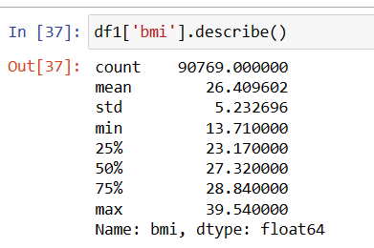
Treating Outliers

Slide 16
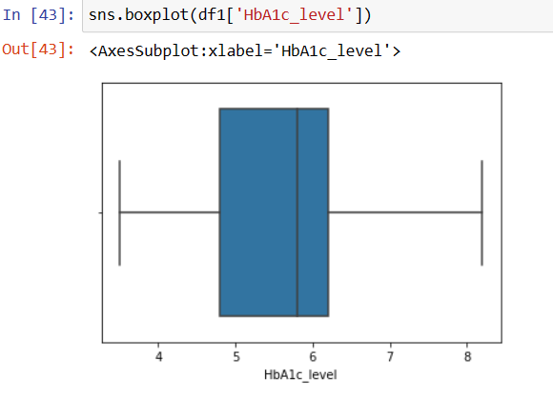
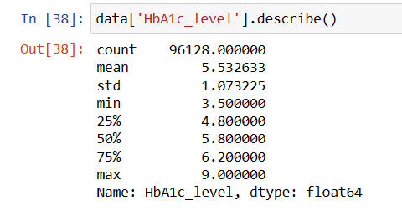
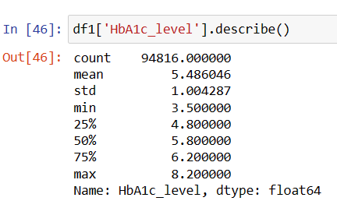

Slide 17
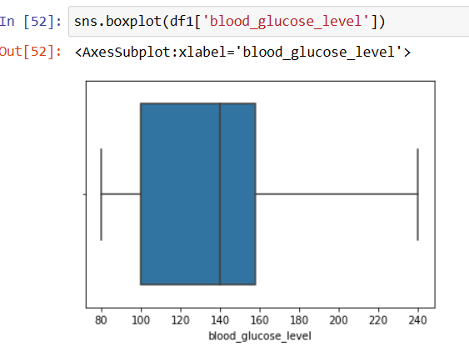
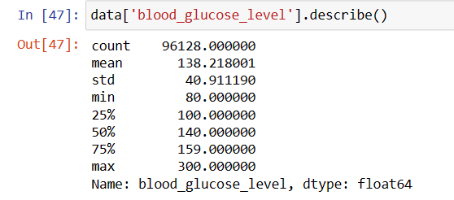
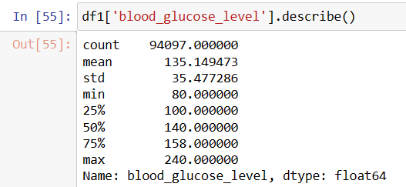

Slide 18
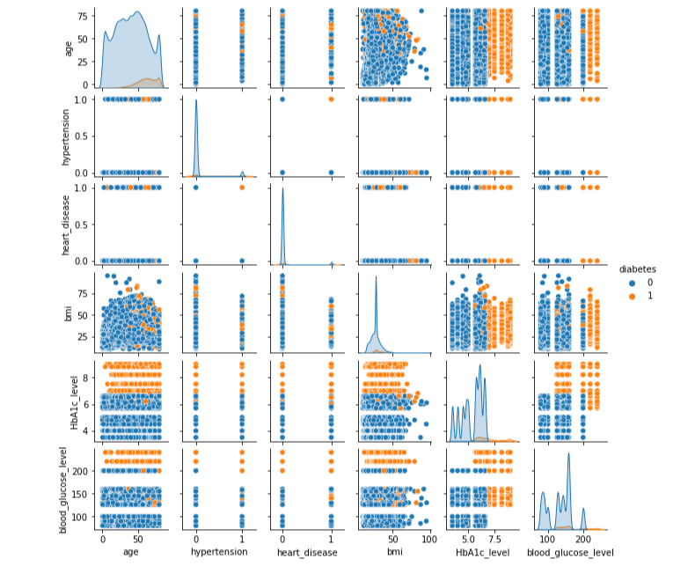
P
A
I
R
P
L
O
T

Slide 19
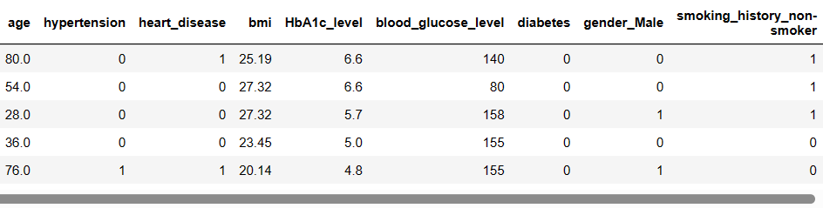
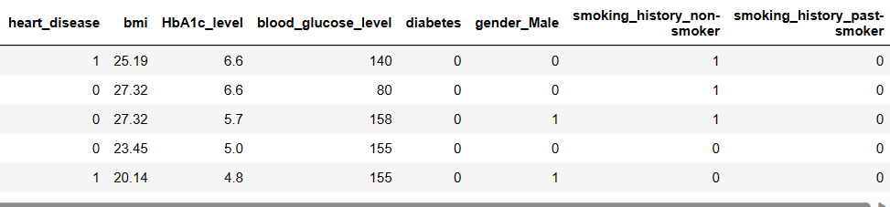
FEATURE ENGINEERING

Slide 20
Predictive Modelling
(ML)

Slide 21
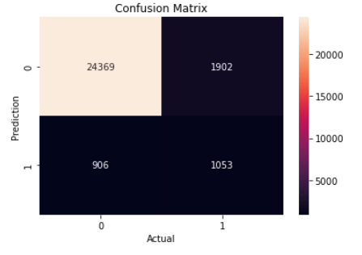
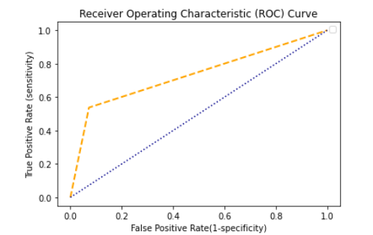
NAIVE BAYES CLASSIFICATION
Confusion Matrix:
[[24369 1902]
[ 906 1053]]
Accuracy: [0.90053135]
Sensitivity : [0.9641543]
Specificity : [0.35634518]
Precision: [0.92760078]
Recall: [0.9641543]
F-score: [0.94552439]
AUC: 0.7325599594706209
ROC curve:

Slide 22
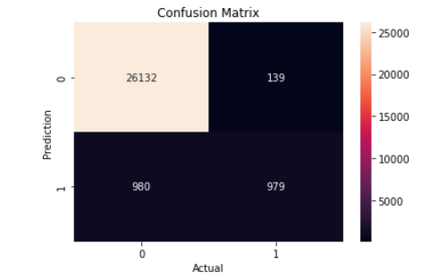
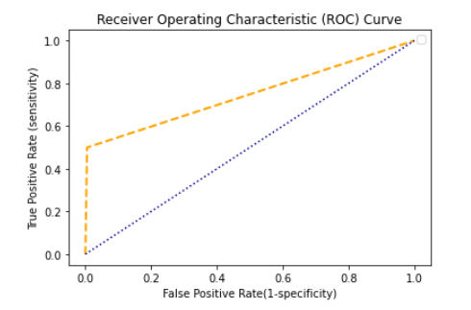
K - Nearest Neighbour
Confusion Matrix:
[[26132 139]
[ 980 979]]
Accuracy: [0.96036132]
Sensitivity : [0.96385364]
Specificity : [0.87567084]
Precision: [0.99470899]
Recall: [0.96385364]
F-score: [0.97903827]
AUC: 0.7472268812238184
ROC curve:

Slide 23
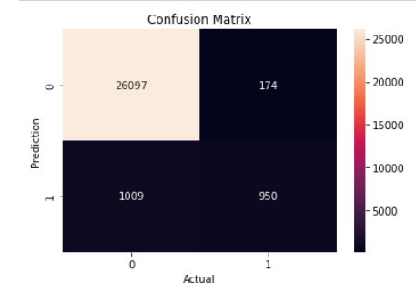
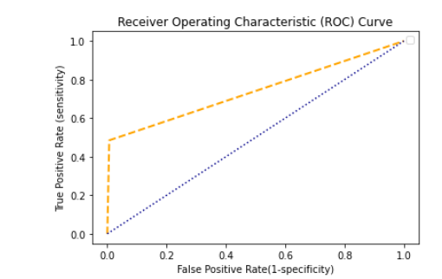
LOGISTIC REGRESSION
Confusion Matrix:
[[26097 174]
[ 1009 950]]
Accuracy: [0.95809423]
Sensitivity : [0.96277577]
Specificity : [0.84519573]
Precision: [0.99337673]
Recall: [0.96277577]
F-score: [0.9778369]
AUC: 0.7391590118847823

Slide 24
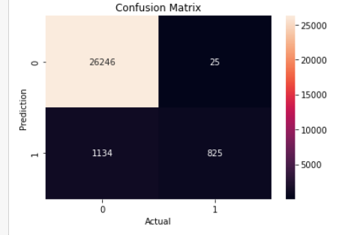
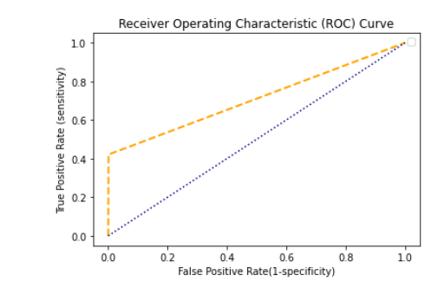
SUPPORT VECTOR MACHINE (SVM)
Confusion Matrix:
[[26246 25]
[ 1134 825]]
Accuracy: [0.95894439]
Sensitivity : [0.95858291]
Specificity : [0.97058824]
Precision: [0.99904838]
Recall: [0.95858291]
F-score: [0.97839742]
AUC: 0.7100908057918867
ROC curve:

Slide 25
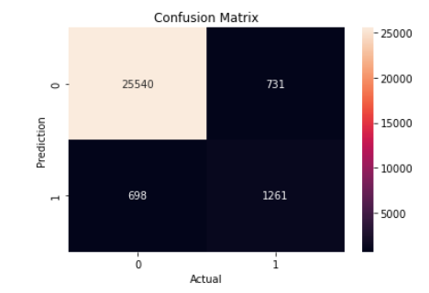
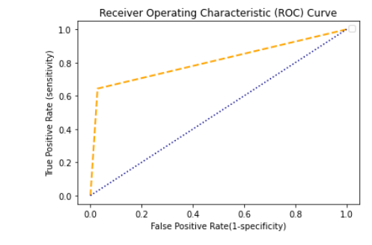
DECISION TREE
Confusion Matrix:
[[25540 731]
[ 698 1261]]
Accuracy: [0.94938009]
Sensitivity : [0.97339736]
Specificity : [0.63303213]
Precision: [0.97217464]
Recall: [0.97339736]
F-score: [0.97278562]
AUC: 0.8079352021919255
ROC curve:

Slide 26
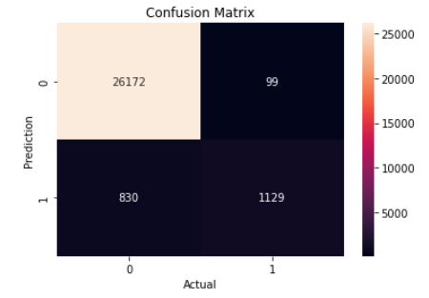
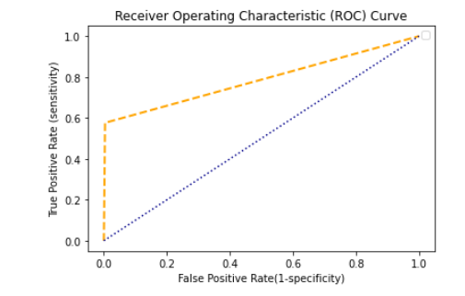
Random Forest
Confusion Matrix:
[[26172 99]
[ 830 1129]]
Accuracy: [0.96709175]
Sensitivity : [0.96926154]
Specificity : [0.99623159]
Precision: [0.96926154]
Recall: [0.96926154]
F-score: [0.98256152]
AUC: 0.7862730161528183
ROC curve:

Slide 27
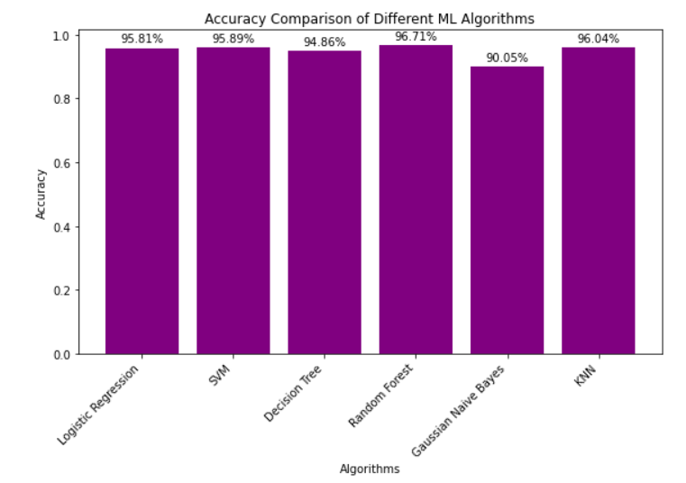
BAR PLOT FOR ACCURACY COMPARISON

Slide 28
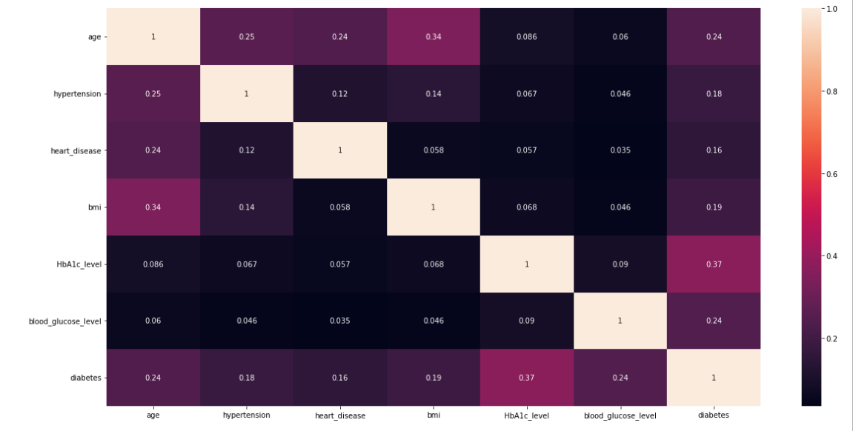
In this project, we attempt to bridge the gap by providing a systematic analysis of the various patient records for the purpose of diabetic prediction.
PROBLEM SOLUTION

Slide 29
THANK YOU

